Slide 1
Artificial evolution
Jae Perris and Joëlle Zweekhorst
Notes:
Paper gave a good overview of the field
Some confusing names for things
Written by a computer scientist
slides
jo: 1, 2, 3, 4, 9, 10, 11, 12, 21, 22, 23, 24, 25, 30, 31, 32, 33, 34
ja: 5, 6, 7, 8, 13, 14, 15, 16, 17, 18, 19, 26, 27, 28, 29

Slide 2
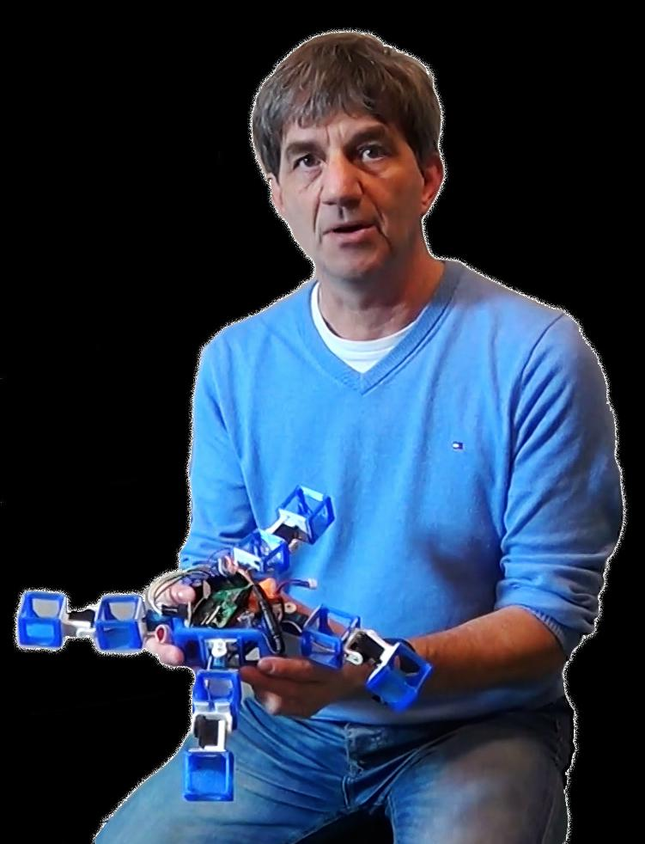
Agoston (Gusz) Eiben
+ Artificial Intelligence on the VU Amsterdam
+ Expert in evolutionary computing
+ Robot babies
Notes:
Gusz Eiben is full professor of Artificial Intelligence on the VU University Amsterdam and visiting professor at the University of York, UK. His research ambition is to achieve artificial intelligence through artificial evolution. He is an expert in evolutionary computing in general and evolutionary robotics in particular. He co-authored the first comprehensive book on evolutionary computing (Introduction to Evolutionary Computing, Springer) and he is the only Dutch computer scientist with a paper in Nature. Currently, he is investigating robots that can learn from each other by exchanging and recombining their brains. Furthermore, he is working on robots that can reproduce and evolve in real time and real space under natural and/or human selection. In 2016 he carried out the first proof-of-concept to demonstrate a “robot baby” parented by two robots. The long-term goal of this research is to understand the co-evolution of the body and the mind.

Slide 3
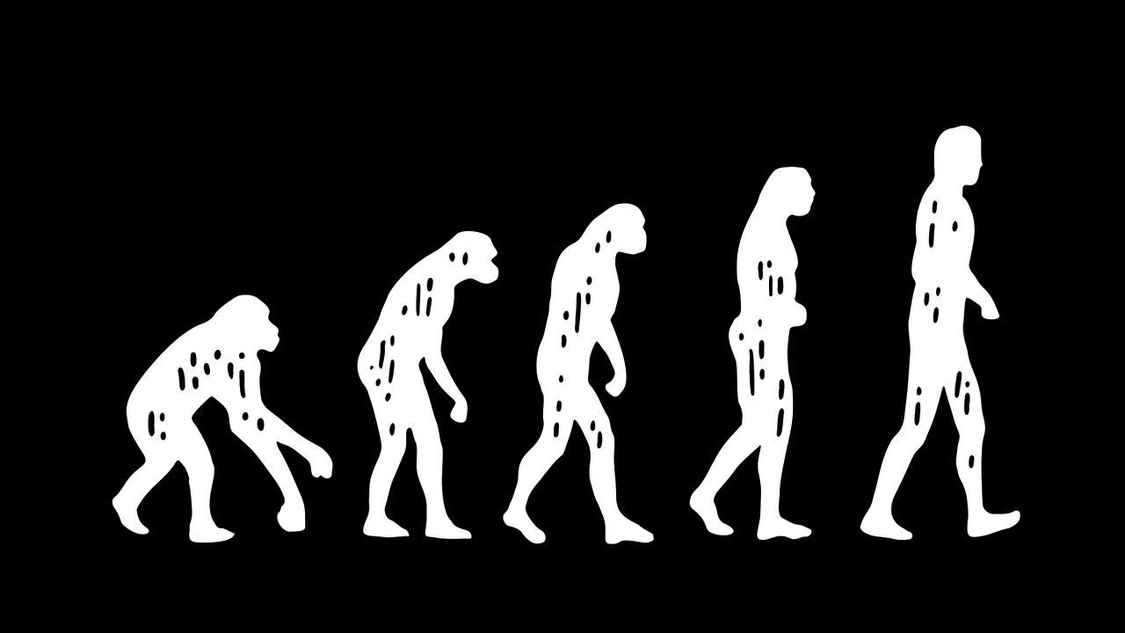
Basing algorithms on nature
+ Darwinian evolution
+ Survival of the fittest
+ Trial and error
Notes:
Evolution supports adaptation to environmental conditions. Diversity in life is as rich as the solution space
Survival of the fittest ensures that through heredity, improvements are passed to offspring.
Evolution is a blind process version of trial and error that is limited by heuristics in the genetic chain

Slide 4
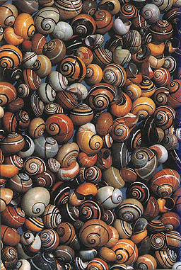
Confusing Terms
Environment, Adaptive Landscape
Individual, Phenotype, Representation
Genotype, genes, genome
Notes:
Differing terms are used within different fields to illustrate the same concept.
Whether you’re looking at it as a computer scientist, psychology, or evolutionary biologist, it changes the terminology
Computer scientists will use any of these terms interchangeably as the field is less governed by dogma than others.

Slide 5
Genotype
+ String of values (genotype)
+ Decoded into the phenotype
+ Holds the uniqueness of each individual
+ Each unit of the string is one ‘gene’
Notes:
Genes can be any information types, but computers like binary, integer, float, string in that order for speed.

Slide 6
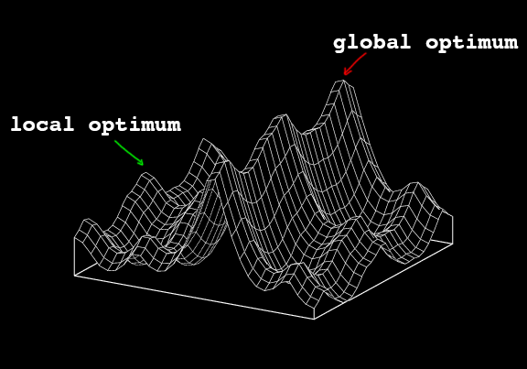
Adaptive landscape
combinations of the successful and less successful traits or phenotypic features become visible
Notes:
Environment reflects ‘adaptive landscape’ which evolution takes place

Slide 7

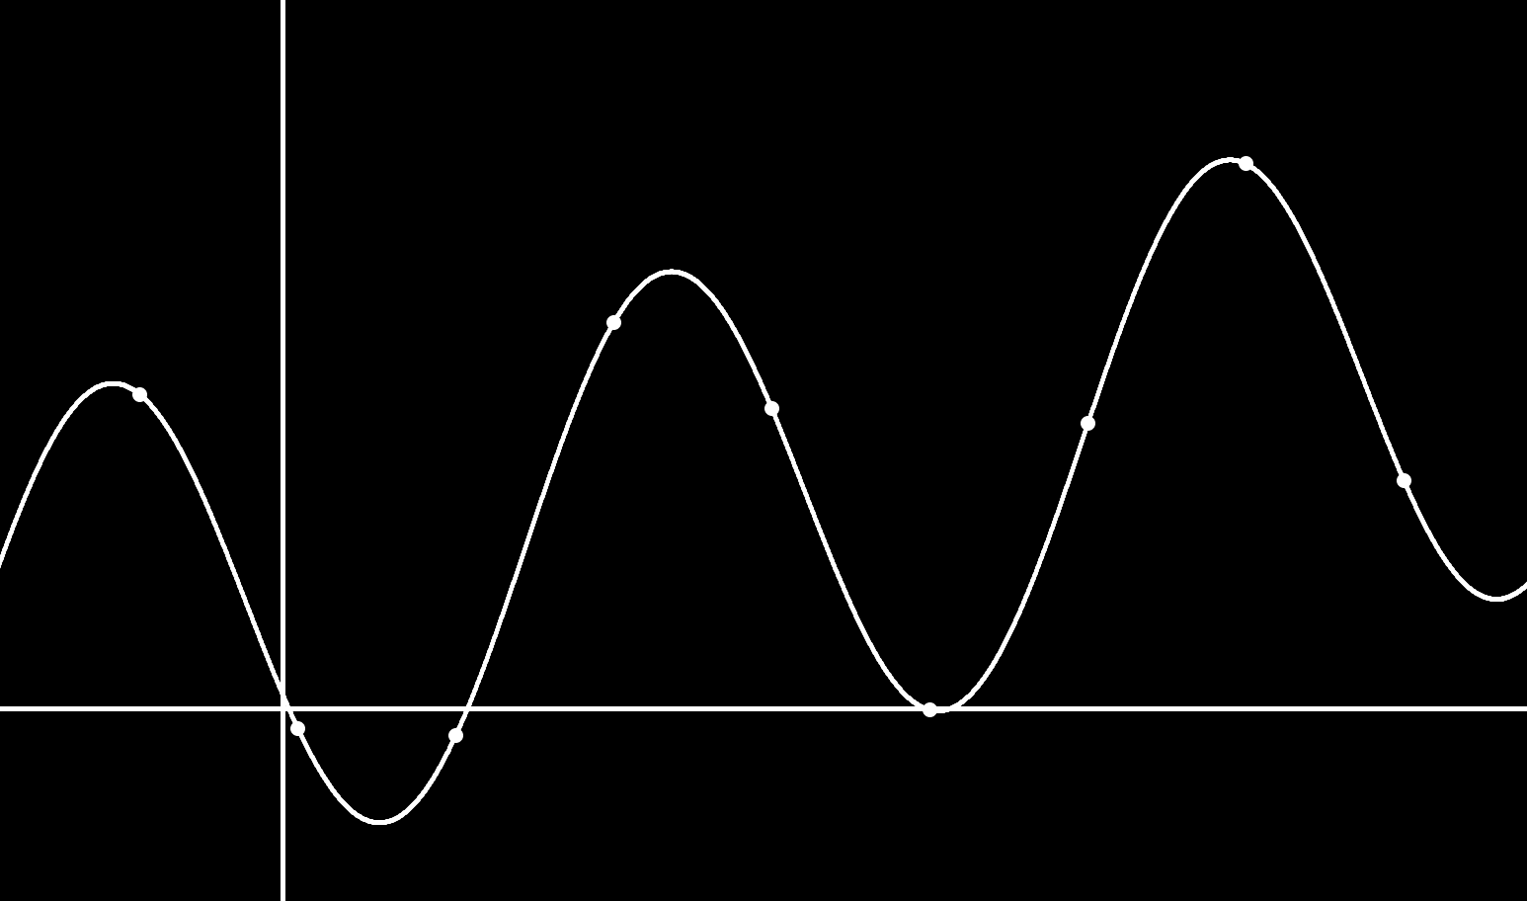
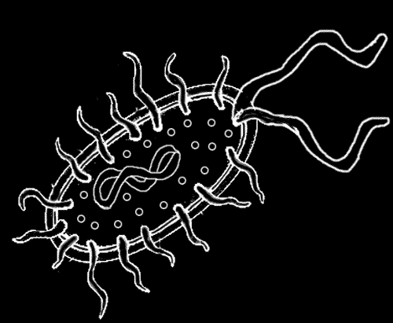
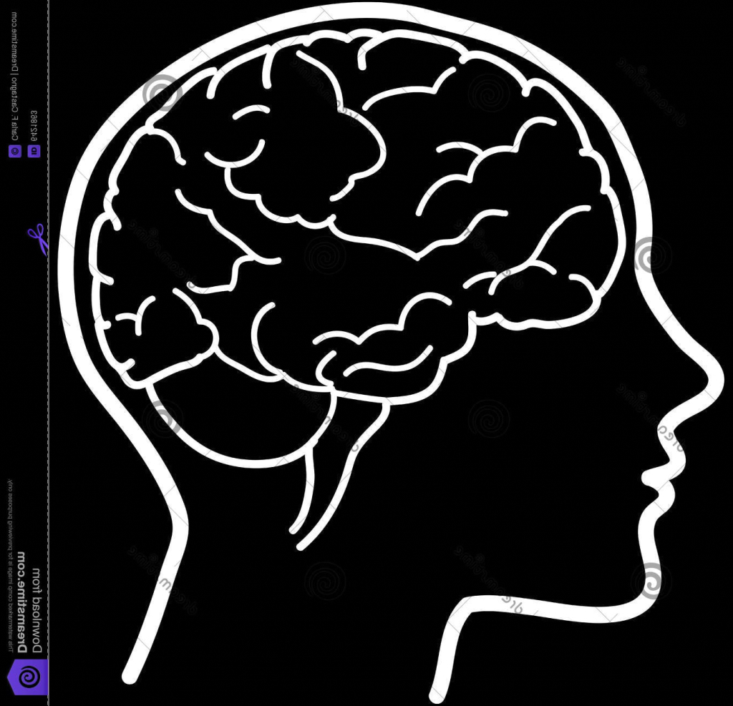
Global and local optimum
Notes:
evolution is the process of gradual advances of the population towards high altitude areas

Slide 8
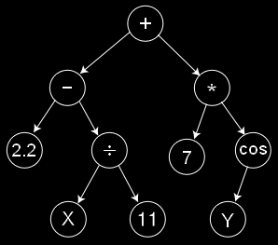
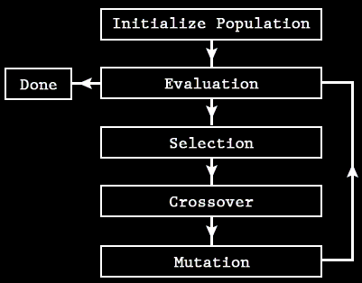
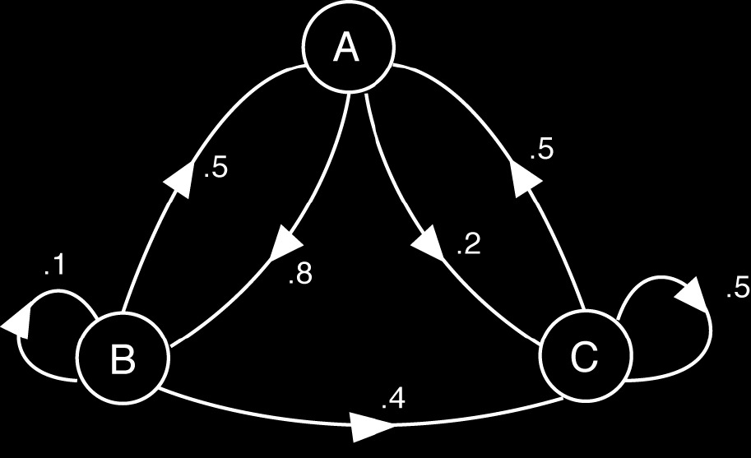
‘Types’ of Evolutionary Algorithms
Genetic Algorithm Markov Chain Genetic Programming
Notes:
Genetic algorithm - 99% of ‘Evolutionary Algorithms’ will use this as their basis.
Markov chain - used in NLP encoding, robotics, manufacturing
Genetic Programming - Tree like structure, also used in NLP, compression algorithms

Slide 9
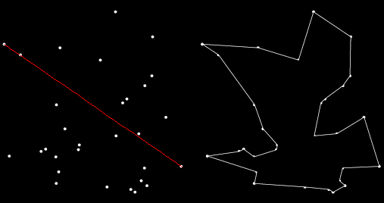
Heuristics
+ Rules of thumb, shortcuts
+ Doesn’t occur in nature, but…
+ Computing needs to be more time efficient
Notes:
not go across
not go to the same point twice

Slide 10
Things needed for a genetic algorithm
+ population
+ representation (of the individual units of selection)
+ fitness function/evaluation function
+ parent/mating selection mechanism
+ crossover(variation operator)
+ mutation (variation operator)
+ replacement/survivor selection mechanism

Slide 11
Population of individuals
+ Survival of the fittest is also
present
+ Fitness determined by phenotypic
features
+ Every individual is different/has
different genotypes
Notes:
this holds the (representation of) possible solutions. it has a set size that is constant (in most cases). a next generation of the population is chosen by looking at the fitness of the individuals. at initialisation, the first population is seeded by randomly generated individuals.
fitness of individuals is determined by their phenotypic features/variations

Slide 12
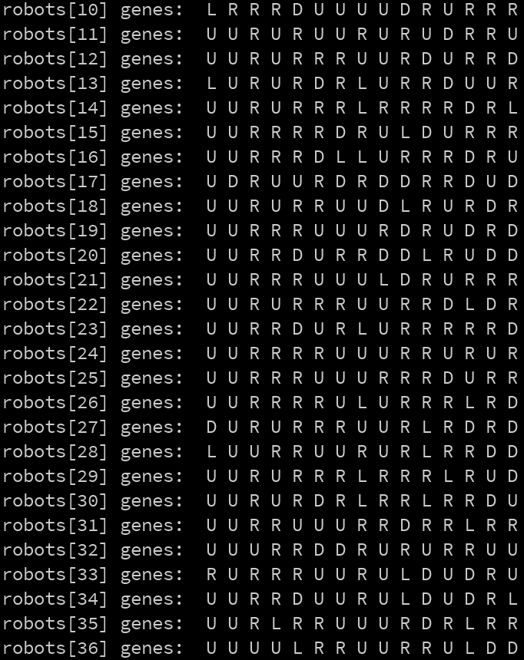

Population
n ~= Gene length
->
Notes:
Starting population should as large as practical.
Guidelines exist, and the presenters have had good experiences with setting the population size roughly equal to the genetic length.
Contains individuals which hold the genetic and behavioral characteristics of our computation.

Slide 13
Things needed for a genetic algorithm
+ population
+ representation (of the individual units of selection)
+ fitness function/evaluation function
+ parent/mating selection mechanism
+ crossover(variation operator)
+ mutation (variation operator)
+ replacement/survivor selection mechanism

Slide 14
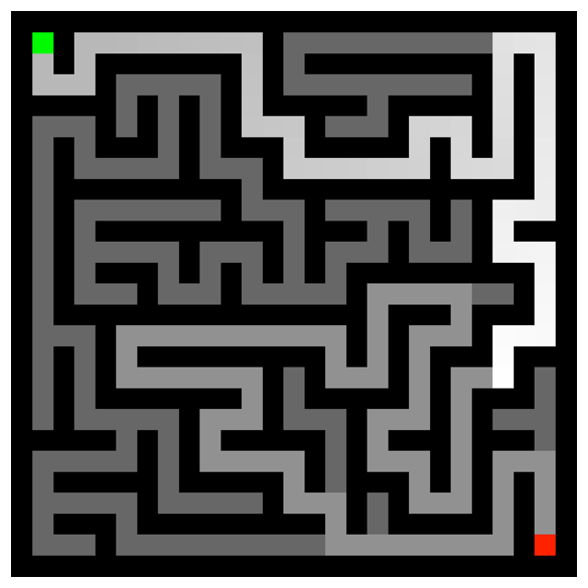
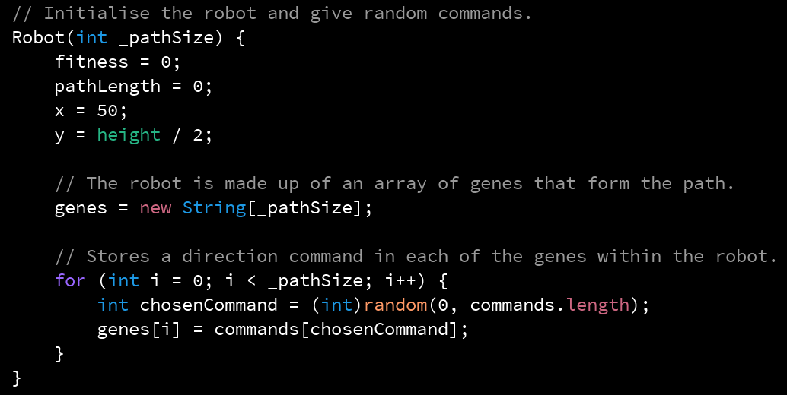
Representation
phenotype (expression of the data)
genotype (arrays, trees, strings ...)
Notes:
Previous slide we saw the genotype, turning into the phenotype.
This is done through a method of ‘representation’ of the data
In nature this is in the organism's behavior, however artificially we may hijack this role.
As a designer we must think about the possibilities of encoding phenotypic behavior into genes, and then invert this process after our generations have gone about their evolutionary step.
do you encode your units of selection? genotype (the data itself) and phenotype (the expression of that data)?

Slide 15
Things needed for a genetic algorithm
+ population
+ representation (of the individual units of selection)
+ fitness function/evaluation function
+ parent/mating selection mechanism
+ crossover(variation operator)
+ mutation (variation operator)
+ replacement/survivor selection mechanism

Slide 16
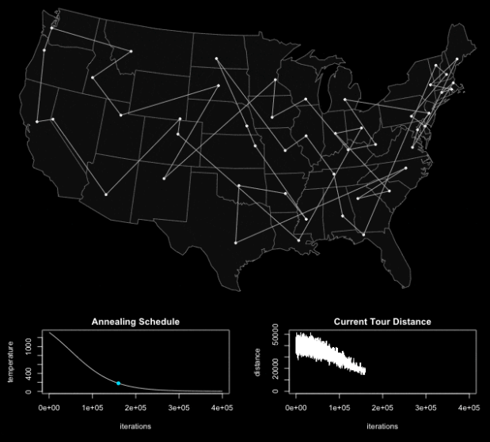
Fitness function
evaluating the performance of the individual
distance aesthetics cost
Notes:
Representation of the requirements to adapt to
The basis of selection/quality measure.
Fitness levels/values can be assigned with the fitness function.
Salesman uses distance
chair: went from 10.3 to 2.9 kg, more efficient
art: he program saves a picture every so many generations so the end was a few hundred thousand generations and half a day of run time. Works by drawing I forget how many thousand random triangles to a bitmap then comparing the rgb values of each pixel to the target image and then mutating and only saving the changes if they made the approximation closer to the target image.

Slide 17

Fitness function
evaluating the performance of the individual
distance aesthetics cost
Notes:
Representation of the requirements to adapt to
The basis of selection/quality measure.
Fitness levels/values can be assigned with the fitness function.
Salesman uses distance
chair: went from 10.3 to 2.9 kg, more efficient
art: he program saves a picture every so many generations so the end was a few hundred thousand generations and half a day of run time. Works by drawing I forget how many thousand random triangles to a bitmap then comparing the rgb values of each pixel to the target image and then mutating and only saving the changes if they made the approximation closer to the target image.

Slide 18
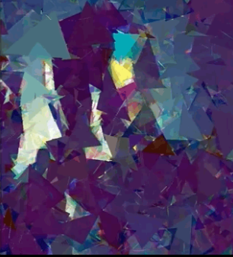
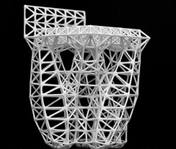
Fitness function
evaluating the performance of the individual
distance aesthetics cost
Notes:
Representation of the requirements to adapt to
The basis of selection/quality measure.
Fitness levels/values can be assigned with the fitness function.
Salesman uses distance
chair: went from 10.3 to 2.9 kg, more efficient
art: he program saves a picture every so many generations so the end was a few hundred thousand generations and half a day of run time. Works by drawing I forget how many thousand random triangles to a bitmap then comparing the rgb values of each pixel to the target image and then mutating and only saving the changes if they made the approximation closer to the target image.

Slide 19
Fitness function
differentiable
float fitness = 1.0/weight * capacity;
Notes:
Fitness function should be differentiable, and continuous
It will primarily determine the direction of solution, and which parameters to optimise

Slide 20
Things needed for a genetic algorithm
+ population
+ representation (of the individual units of selection)
+ fitness function/evaluation function
+ parent/mating selection mechanism
+ crossover(variation operator)
+ mutation (variation operator)
+ replacement/survivor selection mechanism

Slide 21
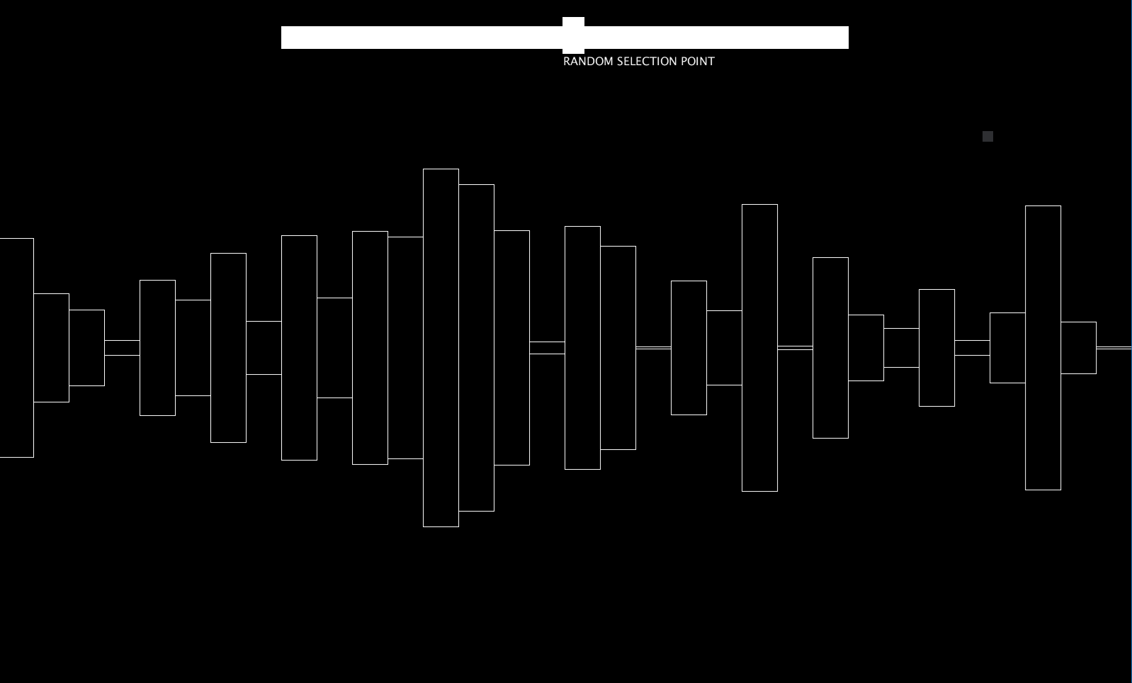
Parent selection mechanism
A method of selection must be chosen. This allows for sampling parents for crossover or recombination.
Options include:
Tournament
Roulette ->
Rank (linear, exponential) etc.
Notes:
better individuals are allowed to become parents of the next generation. at least, high quality individuals have a higher chance of becoming parents than lower quality ones, but the chance still exists. this is to prevent getting stuck in local optimum.

Slide 22
Things needed for a genetic algorithm
+ population
+ representation (of the individual units of selection)
+ fitness function/evaluation function
+ parent/mating selection mechanism
+ crossover(variation operator)
+ mutation (variation operator)
+ replacement/survivor selection mechanism

Slide 23
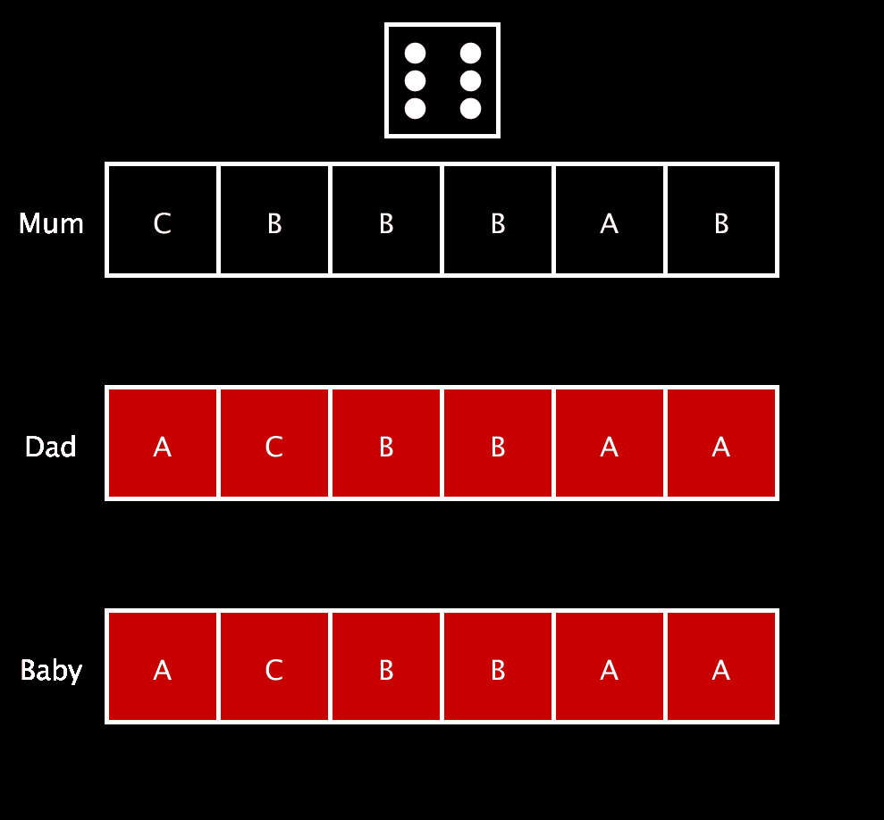
Crossover
Single Cross = Easy
Crossover is the process of recombination of the parent genetic structures to form a child, or new phenotype.
Is it the primary action responsible for generational improvement
Notes:
creating new individuals from old ones by merging information form two parent genotypes into one offspring. the choice of what parts of the parents are combined is random. some may have worse combinations than their parents, but some might have improved characteristics.

Slide 24
Things needed for a genetic algorithm
+ population
+ representation (of the individual units of selection)
+ fitness function/evaluation function
+ parent/mating selection mechanism
+ crossover(variation operator)
+ mutation (variation operator)
+ replacement/survivor selection mechanism

Slide 25
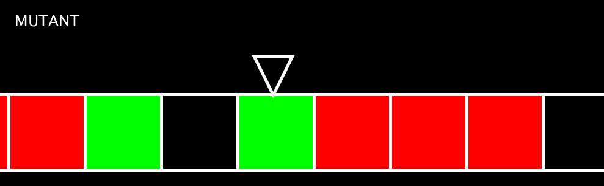
Mutation
p ~= 5%
Mutation is the process of introducing new solutions to the population by means of random changes to an individual gene
It is the primary operator that allows for ‘genetic drift’ away from local maxima
Notes:
creating new individuals from old ones by slightly modifying the child of a previous generation with random data. randomness is important here, no heuristic of biased operator can be used, or it wouldn’t really be a mutation. mutation can guarantee a connection with other (previously looked at) individuals and can thus help discovering global optimum.

Slide 26
Things needed for a genetic algorithm
+ population
+ representation (of the individual units of selection)
+ fitness function/evaluation function
+ parent/mating selection mechanism
+ crossover(variation operator)
+ mutation (variation operator)
+ replacement/survivor selection mechanism

Slide 27
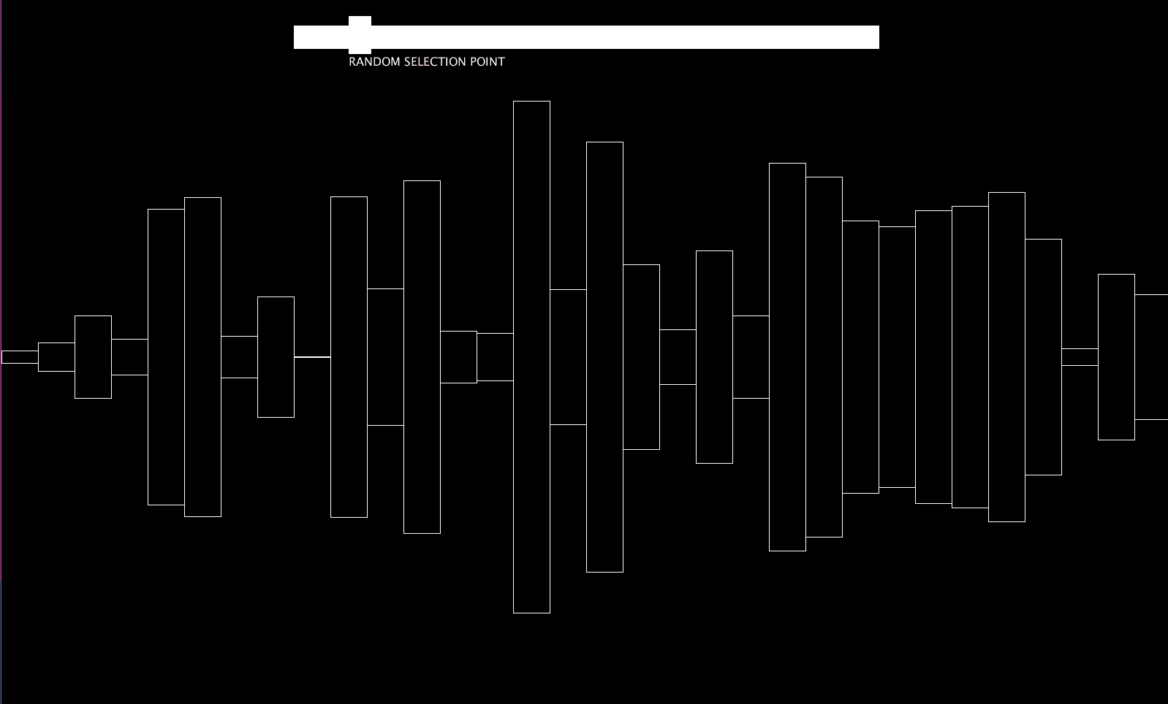
Survivor selection mechanism
+ Similar to parent selection
+ Adjust to the population size
Here we can see the red-
selected organism will
not endure the winter.
Notes:
similar to parent selection, but in a different stage.
Population has a set size, a choice has to be made which individuals will be allowed to live.
Higher quality individuals (both offspring and parents) have a higher chance of being selected to live.
Have shown the grim-reaper approach to survivor selection, by randomly killing the weakness.

Slide 28

Algorithm termination
If every individual in the population is a potential solution, when do we stop running an algorithm?
+ Optimal fitness level is reached
+ Population diversity gets too low
+ Average fitness isn’t improving enough
+ Time/cpu limit is reached.

Slide 29
Concluding Remarks - Design
Inferable by Problem | Experience/experimentation
Fitness Heuristics Representation ~Gene Length | Mutation Rate Selection Method Population Size ~Gene Length

Slide 30
An example!
+ Lecture schedules
+ Fitness determined by for instance:
double booked rooms (lowers fitness)
activities spread out over a week (increases fitness)

Slide 31
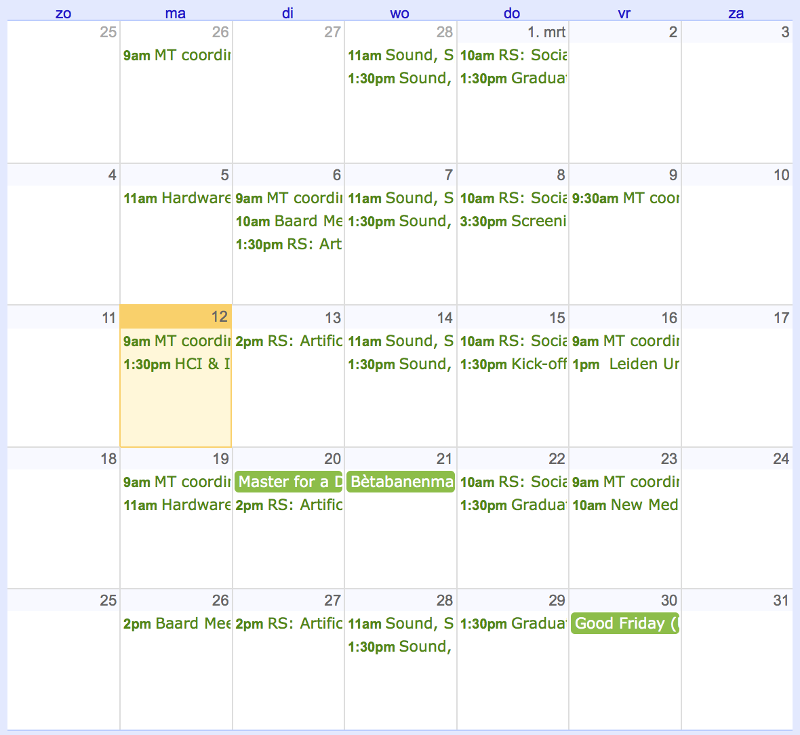
An example!
+ Lecture schedules

Slide 32
An example!
Travelling Salesman
+ Must travel to each point once.
+ Fitness is determined by minimising travel distance
+ Difficulty is O(n!) -> factorial growth

Slide 33
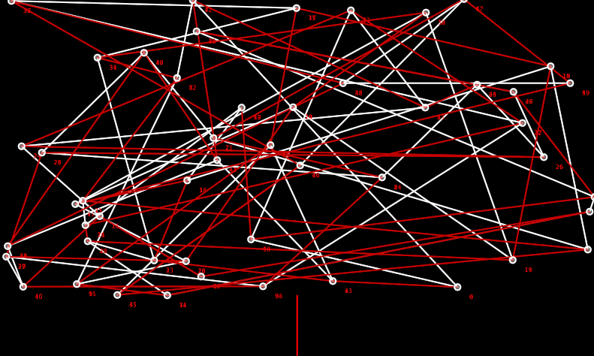
An example!
Travelling Salesman

Slide 34
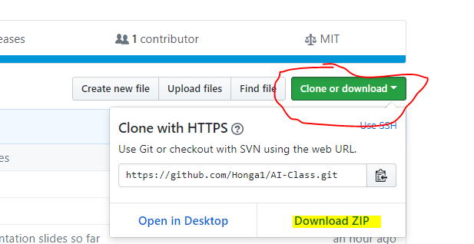
Lab assignment
https://github.com/Honga1/AI-Class/
Notes:
show the final working code, with the obstacles in it
give class about 10/15 minutes to get familiar with the code, try to see if they know how so solve the todos
as a group try to solve the todos, ask people if they know the answers, ask them to come to the front to write them down
maybe a little discussion if it’s necessary
DONE

